Slide 1
flute
brief introduction of

Slide 2
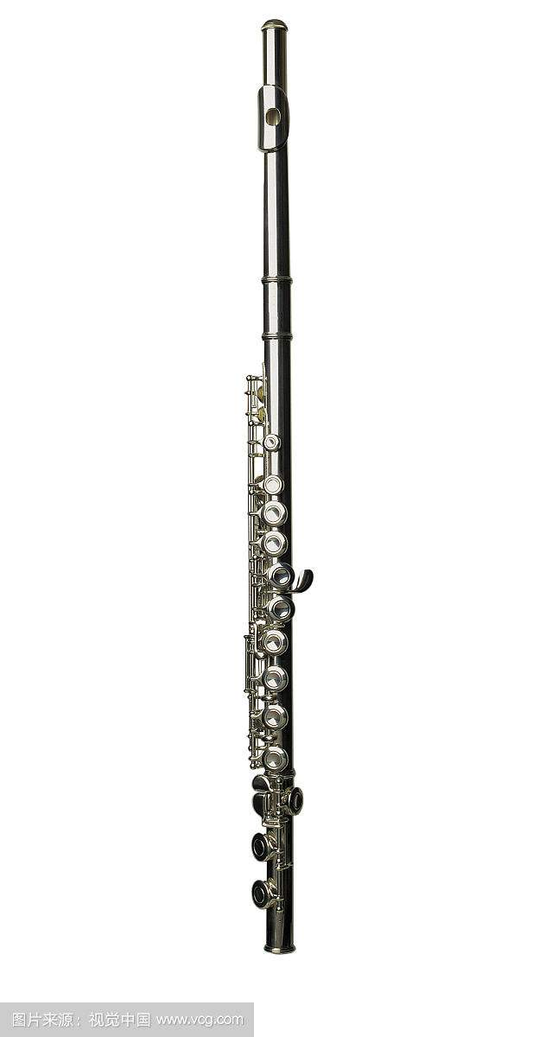
The flute is a family of musical instruments in the woodwind group. Unlike woodwind instruments with reeds, a flute is an aerophone or reedless wind instrument that produces its sound from the flow of air across an opening. According to the instrument classification of Hornbostel–Sachs, flutes are categorized as edge-blown aerophones.

Slide 3
The Western concert flute, a descendant of the medieval German flute, is a transverse treble flute that is closed at the top. An embouchure hole is positioned near the top across and into which the flutist blows. The flute has circular tone holes larger than the finger holes of its baroque predecessors. The size and placement of tone holes, key mechanism, and fingering system used to produce the notes in the flute's range were evolved from 1832 to 1847 by Theobald Boehm and greatly improved the instrument's dynamic range and intonation over its predecessors.^{[39]} With some refinements (and the rare exception of the Kingma system and other custom adapted fingering systems), Western concert flutes typically conform to Boehm's design, known as the Boehm system. Beginner's flutes are made of nickel, silver, or brass that is silver-plated, while professionals use solid silver, gold, and sometimes platinum flutes. There are also modern wooden-bodied flutes usually with silver or gold keywork. The wood is usually African Blackwood.
The standard concert flute is pitched in C and has a range of three octaves starting from middle C or one half step lower when a B foot is attached. This means the concert flute is one of the highest common orchestra and concert band instruments.
Western transverse flutes

Slide 4
A flute produces sound when a stream of air directed across a hole in the instrument creates a vibration of air at the hole.The airstream creates a Bernoulli or siphon. This excites the air contained in the usually cylindrical resonant cavity within the flute. The flutist changes the pitch of the sound produced by opening and closing holes in the body of the instrument, thus changing the effective length of the resonator and its corresponding resonant frequency. By varying the air pressure, a flutist can also change the pitch by causing the air in the flute to resonate at a harmonic rather than the fundamental frequency without opening or closing any holes.
Head joint geometry appears particularly critical to acoustic performance and tone, but there is no clear consensus on a particular shape amongst manufacturers. Acoustic impedance of the embouchure hole appears the most critical parameter.Critical variables affecting this acoustic impedance include: chimney length (hole between lip-plate and head tube), chimney diameter, and radii or curvature of the ends of the chimney and any designed restriction in the "throat" of the instrument, such as that in the Japanese Nohkan Flute.
Acoustics

Slide 5
minuet Georges Bizet
Prélude à l’aprèsmidi d’un faune (Prelude to the Afternoon of a Faun; completed in 1894) Claude Debussy
concertino Chaminade
representative work

Slide 6
• Buchanan, Donna A. 2001. "Bulgaria §II: Traditional Music, 2: Characteristics of Pre-Socialist Musical Culture, 1800–1944, (iii): Instruments". The New Grove Dictionary of Music and Musicians, second edition, edited by Stanley Sadie and John Tyrrell. London: Macmillan Publishers.
• Crane, Frederick. 1972. Extant Medieval Musical Instruments: A Provisional Catalogue by Types. Iowa City: University of Iowa Press. ISBN 0-87745-022-6
• Galway, James. 1982. Flute. Yehudi Menuhin Music Guides. London: Macdonald. ISBN 0-356-04711-3 (cloth); ISBN 0-356-04712-1 (pbk.) New York: Schirmer Books. ISBN 0-02-871380-X Reprinted 1990, London: Kahn & Averill London: Khan & Averill ISBN 1-871082-13-7
• Phelan, James, 2004. The Complete Guide to the [Flute and Piccolo], second edition. [S.l.]: Burkart-Phelan, Inc., 2004. ISBN 0-9703753-0-1
• Putnik, Edwin. 1970. The Art of Flute Playing. Evanston, Illinois: Summy-Birchard Inc. Revised edition 1973, Princeton, New Jersey and Evanston, Illinois. ISBN 0-87487-077-1
• Toff, Nancy. 1985. The Flute Book: A Complete Guide for Students and Performers. New York: Charles's Scribners Sons. ISBN 0-684-18241-6 Newton Abbot: David & Charles. ISBN 0-7153-8771-5 Second Edition 1996, New York: Oxford University Press. ISBN 0-19-510502-8
• Wye, Trevor. 1988. Proper Flute Playing: A Companion to the Practice Books. London: Novello. ISBN 0-7119-8465-4
• Maclagan, Susan J. "A Dictionary for the Modern Flutist", 2009, Lanham, Maryland, USA: Scarecrow Press. ISBN 978-0-8108-6711-6
Bibliography

Slide 7
Thank you

